Slide 1
House Price Prediction for Washington Cities
The Outliers:
Sagar Bansal, Yiqing Bu, Parth Padia, Ziting Yuan

Slide 2
AGENDA
Introduction
Data Characteristics
Initial Multiple Linear Regression Model
Transformed Model
Analysis Summary

Slide 3
Introduction

Slide 4
Introduction
Motivation of analysis:
In the Real Estate Industry, understanding the trend of property prices is an invaluable tool as they are generally good indicators of economy.
Project Goals:
For this purpose , we have chosen a sample of 10 cities from the dataset of house prices to conduct our analysis.
Notes:
1)Knowing the price trends of houses of the real estate sector can be beneficial as they are generally considered good indicators of the economic status and market condition of a country.
2) Our Analysis will include how different factors such as area of the house , age of the house , its amenities such as no. of baths and beds etc are correlated with the price of a house from these 10 cities. The 10 cities studied include Seattle, Renton, Bellevue, Redmond, Kirkland, Issaquah, Kent, Auburn, Sammamish and Federal Way.

Slide 5
Data Characteristics

Slide 6
Data Characteristics
Original Data Description:
Observational and Cross-sectional in nature
4,600 number of observations & 18 variables
Cleaned Data:
3,412 number of observations
Predictors:-
Quantitative - Sqft_living, Sqft_lot, Bathrooms,
Bedrooms, Age of the house and Floors.
Qualitative - City.
Response - Price
Notes:
The data provided is cross-sectional in nature as the data records are a group of houses from May, 2014 to July 2014 and not for a particular house over a certain period of time. Also, this is an observational study since our data was collected first and then, we hypothesised the model.
Sqft_living refers to the total living area of the house which includes the basement(if any) , Sqft_lot refers to the total area of the property the house is built upon , age of the house has been calculated by subtracting 2014 from the column yr_built (which indicates the year the house was built) thus giving us its age. City is a qualitative variable that tells us the location of the house.

Slide 7
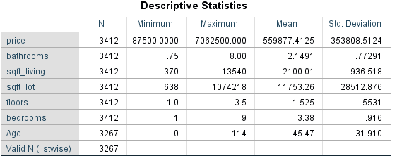
Data Characteristics
Table showing summary statistics of quantitative data used
Initial Relationship with Price: Some simple scatter plots show a positively correlated relationship with price between “Sqft_Living’’ and “No. of Bathrooms”, indicating that houses with more number of bathrooms and houses with more square footage of living area tend to have higher prices. Additionally , a boxplot of price by city shows different ranges of house price values (minimum to maximum) for different cities. This observation gives us a strong indication that the city name can be correlated with house prices.
We have selected the 7 most impactful predictors according to our research from the given dataset.
Notes:
City is a qualitative variable while all the other predictors are quantitative variables. Initial scatter plot diagrams show a positive correlation b/w price and sqft_living & no. of bathrooms. The remaining predictors were also plotted against Price but we could not see any initial observations that could indicate a correlation of Bedrooms, Sqft_lot, Floors and Age variables with our response variable. Notwithstanding, we would like to confirm these observations using our model.

Slide 8
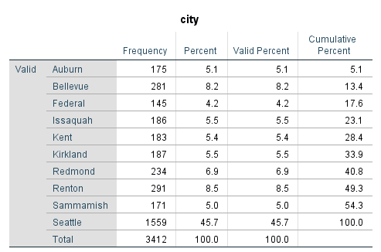
Data Characteristics
Frequency of the ten cities studied
Initial Relationship with Price: Some simple scatter plots show a positively correlated relationship with price between “Sqft_Living’’ and “No. of Bathrooms”, indicating that houses with more number of bathrooms and houses with more square footage of living area tend to have higher prices. Additionally , a boxplot of price by city shows different ranges of house price values (minimum to maximum) for different cities. This observation gives us a strong indication that the city name can be correlated with house prices.
We have selected the 7 most impactful predictors according to our research from the given dataset.
Notes:
City is a qualitative variable while all the other predictors are quantitative variables. Initial scatter plot diagrams show a positive correlation b/w price and sqft_living & no. of bathrooms. The remaining predictors were also plotted against Price but we could not see any initial observations that could indicate a correlation of Bedrooms, Sqft_lot, Floors and Age variables with our response variable. Notwithstanding, we would like to confirm these observations using our model.

Slide 9
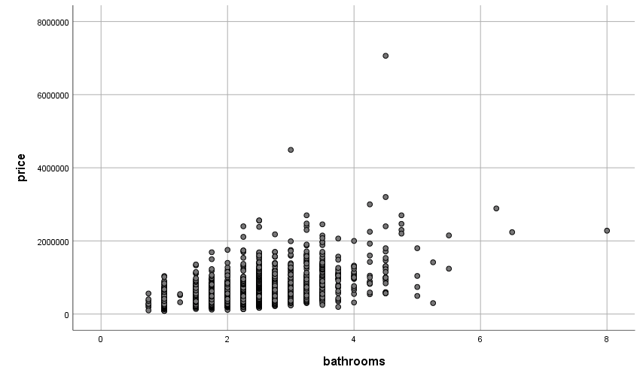
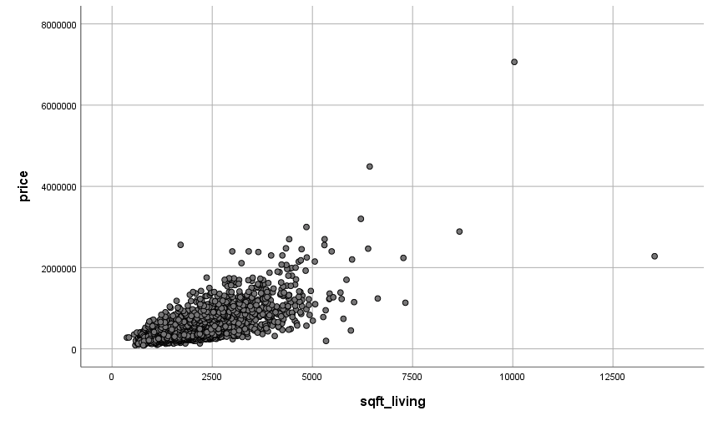
Data Characteristics
Scatter plot of Price vs no. of Bathrooms
Scatter Plot of Price vs Sqft_Living
Notes:
Price and Sqft_living are found to be positively correlated
Price and no. of bathrooms are found to positively correlated
Price and City may share a correlation.
Here we can see the scatter plot diagram of Price vs Bathrooms and Price vs Sqft_Living from which we can infer that a positively correlated linear relationship exists.

Slide 10
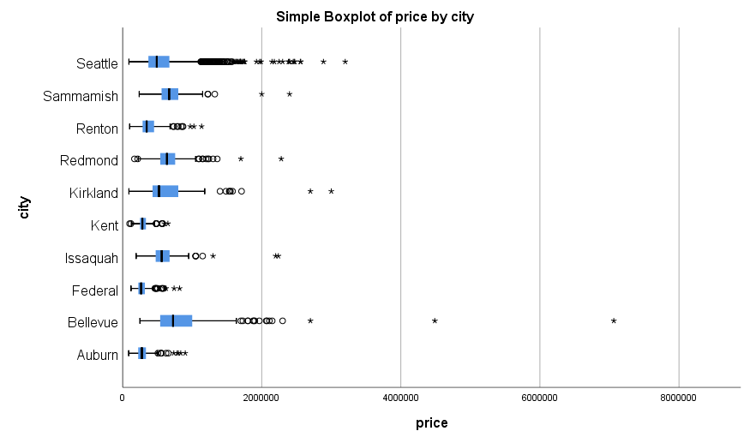
Data Characteristics
Notes:
Additionally, the box plot shows different ranges of house price values (minimum to maximum) for different cities. This observation gives us a strong indication that the city name can be correlated with house prices

Slide 11
Initial Multiple Linear Regression Model

Slide 12
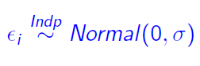
Hypothesized Model
Price = b₀ + b₁Bedroom + b₂Bathroom + b₃Sqft_living + b₄Floors + b₅Sqft_lot + b₆AgeoftheHouse + b_{c1}CitySeattle + b_{c2}CityRenton + b_{c3}CityBellevue + b_{c4}CityRedmond + b_{c5}CityKirkland + b_{c6}CityIssaquah + b_{c7}Kent + b_{c8}Auburn + b_{c9}Sammamish + e
Assumptions:
Federal Way is treated as the reference level!
.

Slide 13
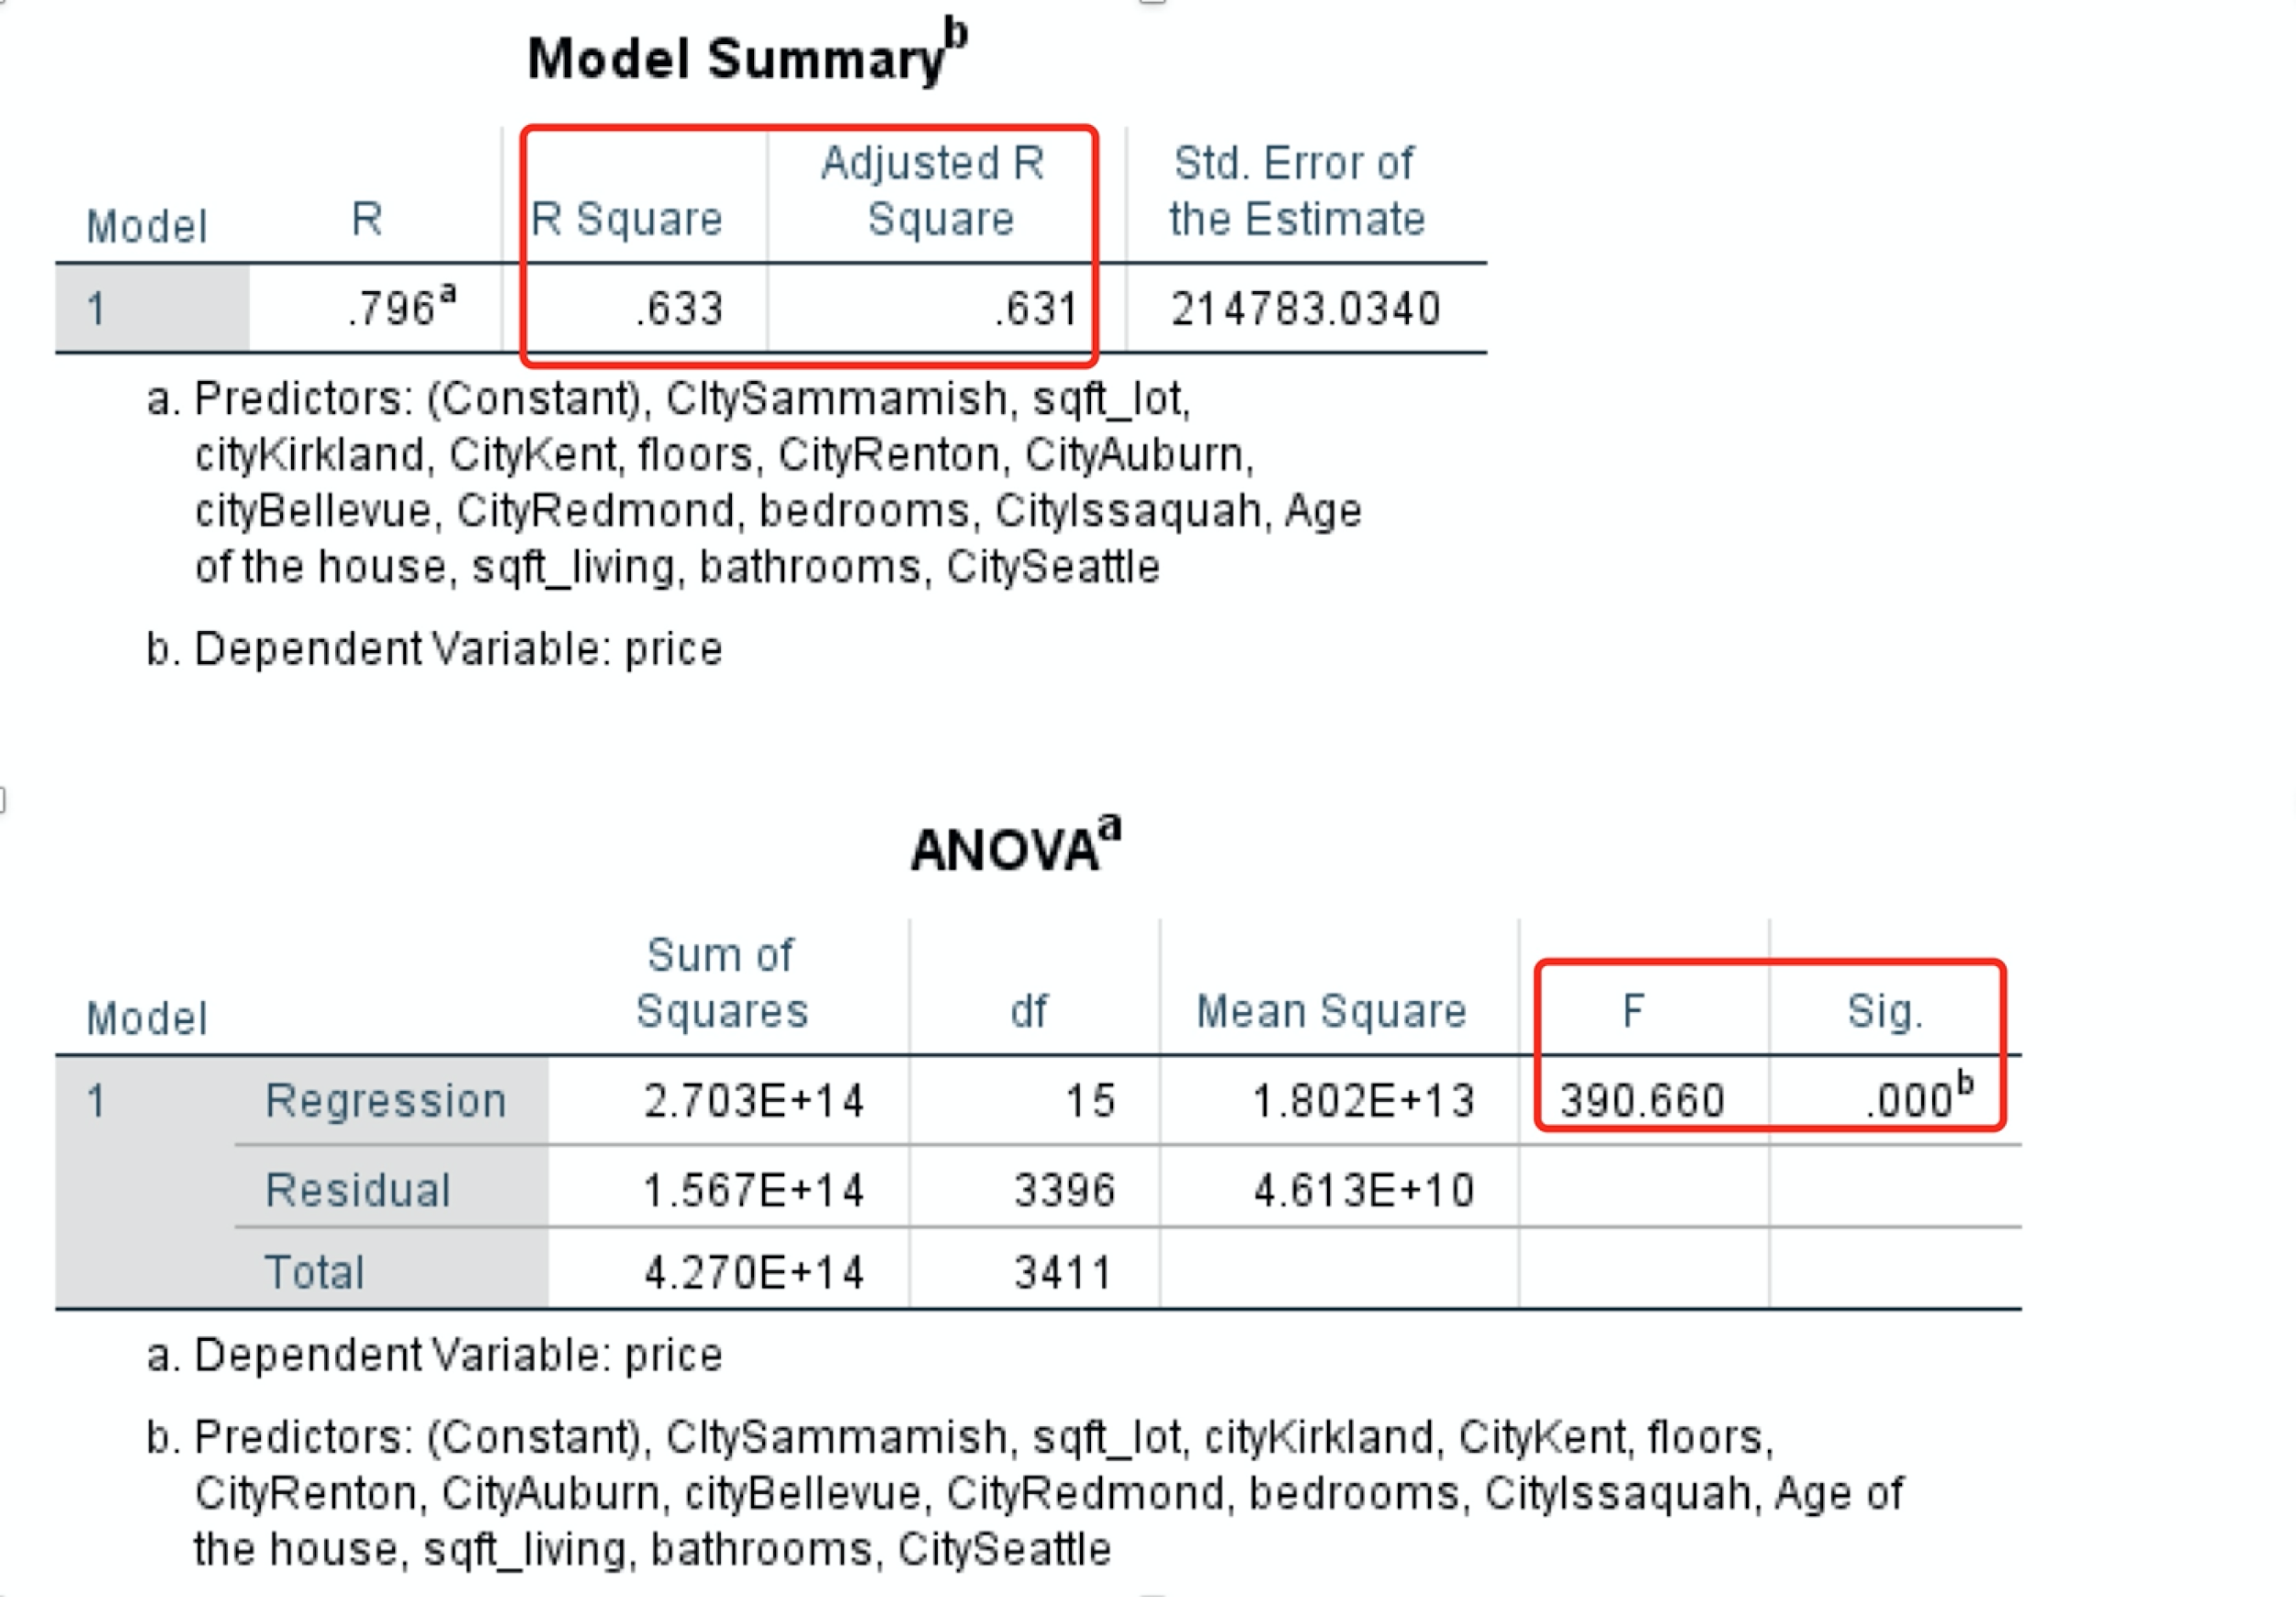
Check Utility
Notes:
Adjusted R
MSE: The Root mean square error is found to be good but not that great
F-Test (reduce Type I Error)

Slide 14
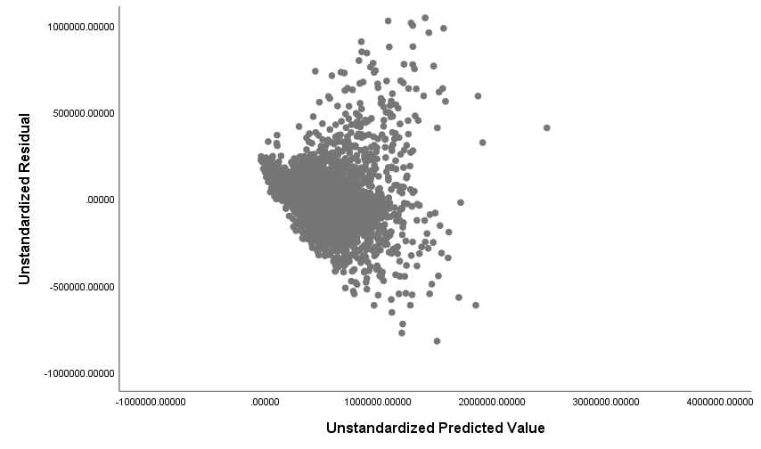
Check Lack of Fit & Homogeneity
Multiplicative pattern
Lack of Fit
Have heterogeneity issue
Need to modify the model
Residual vs. Fitted Values Plot

Slide 15
Transformed Model

Slide 16
Transformed Model
ln(Price) = b₀ + b₁Bedroom + b₂Bathroom + b₃Sqft_living + b₄Floors + b₅Sqft_lot + b₆AgeoftheHouse + b_{c1}CitySeattle + b_{c2}CityRenton + b_{c3}CityBellevue + b_{c4}CityRedmond + b_{c5}CityKirkland + b_{c6}CityIssaquah + b_{c7}Kent + b_{c8}Auburn + b_{c9}Sammamish + e
Assumptions:
Federal Way is treated as the reference level!
.
Notes:
b0 is the mean value of the nature log of the response when X = 0
A unit increase in X is associated with an increase of 1 in the mean of the natural log of the response

Slide 17
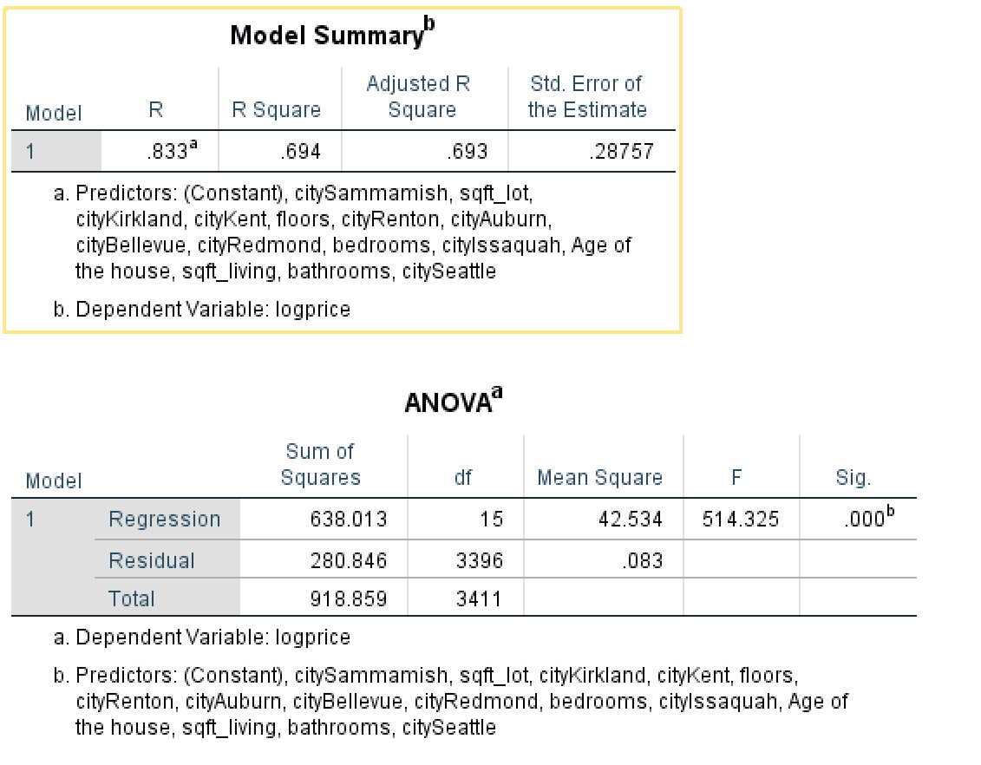
Check Utility
Notes:
The R2 indicates that a higher proportion ( 69.4%) of the variability in the hospitalizations is explained by the predictors.

Slide 18
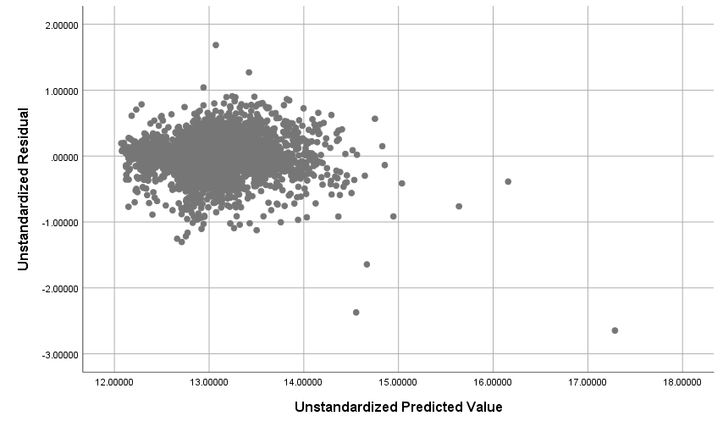
Check Lack of Fit & Homogeneity
Data evenly spread out
No obvious pattern

Slide 19
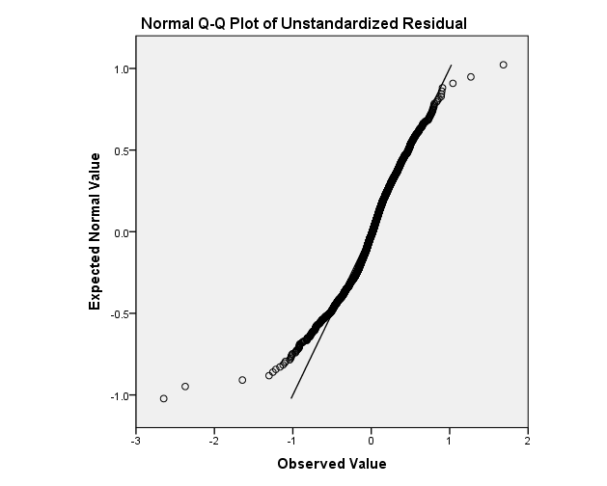
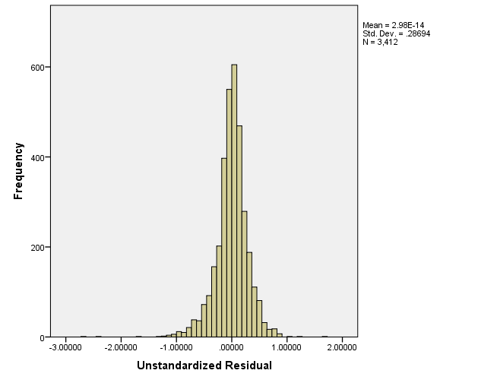
Checking Normality
Residuals appear closer to normal line
Almost normally distributed
Future work will need further investigation
Notes:
From the Q-Q Plot , we can observe that although there is some deviation at the ends , we see that the residuals are generally much closer to Normal now, indicating there is no major violation of the Normality assumption. However, further investigation may be required for any future work to be carried out in order to get more clarity.

Slide 20
Checking Independence
No time-series structure
No need to perform Durbin-Watson test
Therefore, we assume that error terms are independent of each other
Notes:
From the Q-Q Plot, we see that the residuals are much closer to Normal now, indicating there is no major violation of the Normality assumption

Slide 21
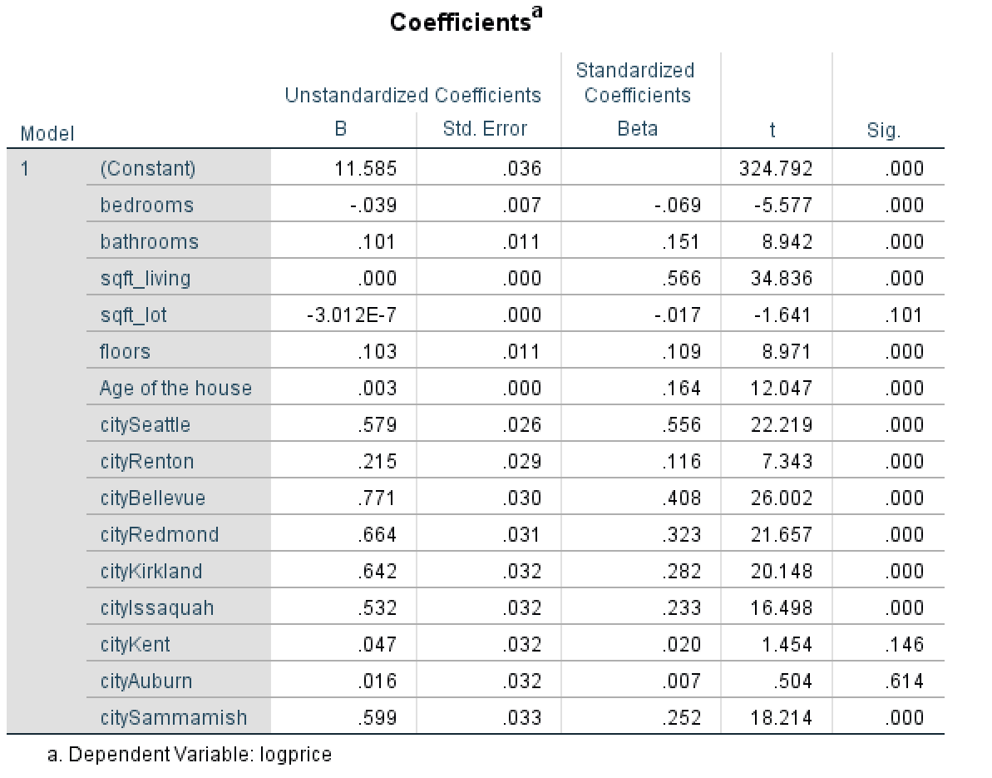
Model Interpretation
Only Sqft_lot, CityKent, CityAuburn are not statistically significant
Coefficients of bedrooms and Sqft_lot are negative
Notes:
b0 is the mean value of the nature log of the response when X = 0
A unit increase in X is associated with an increase of 1 in the mean of the natural log of the response

Slide 22
Summary

Slide 23
Analysis Summary
All cities except Kent and Auburn are statistically different from Federal Way
The house prices of Federal Way are least expensive among the ten cities which we have been studied.
Since bedroom has negative correlation with house price, in the future study, we could conduct further investigation to figure out why bedroom does not have positive relationship with house price.
The model cannot be used for forecasting future house prices.

Slide 24
Thank You!

